Slide 1
Predictive Analytics on Repair Industry around the Globe

Slide 2
GROUP MEMBERS:
MUHAMMAD UZAIR MSDS20053
ABDULLAH AZIZ MSDS20052
KHUZAIMA SHAHID MSDS20039
MUHAMMAD MUBASHIR ALI MSDS20085
QAZI DANISH AYUB MSDS20075
HIRA SALEEM MSDS20104
RAMEESHA MAHMOOD MSDS20089
MUHAMMAD ARSLAN AFZAL MSDS20035
AAFAQ IQBAL KHAN MSDS20016
Ahmad Nawaz MSDS20093

Slide 3
ABSTRACT
An industry that has fiercely made its existence in the market, it’s the cell phone repair industry. Since 2012 this industry has been grown over 5.5% average growth rate and currently, there are more than 8000 businesses registered with an annual profit of $272.5m in 2018 and has increased to $400m in 2020 (IBIS World Report), worthy indeed.
The mobile network, like American Express, is combining customer transaction and interactions data to predict customer fluctuations.
By utilizing internal information on billing and customer relations management along with data on social media usage, T-Moblile USA claims they halved customer defections within a single quarter. The company has integrated the data gathering tools across its' IT systems.

Slide 4
PROBLEM STATEMENTS
Reducing customer churn using predictive analytics
Revenue projection on the basis of sales data
Classification of vendors which are strategically important and critical to business
Revenue estimation trends forcasting using regression analysis

Slide 5
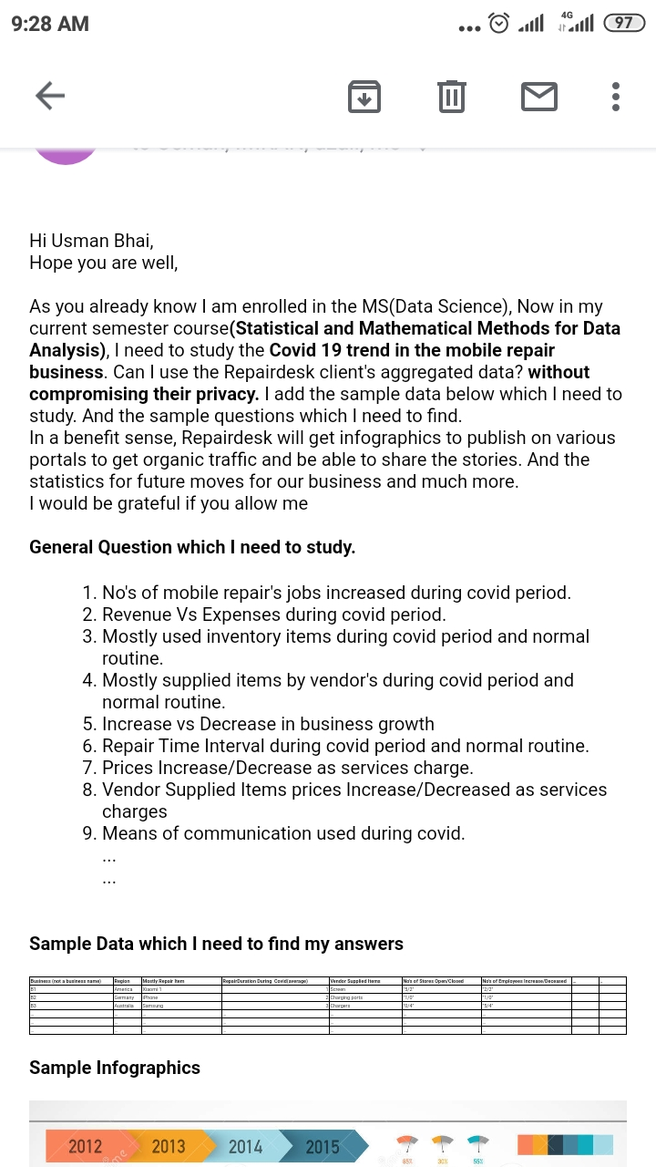
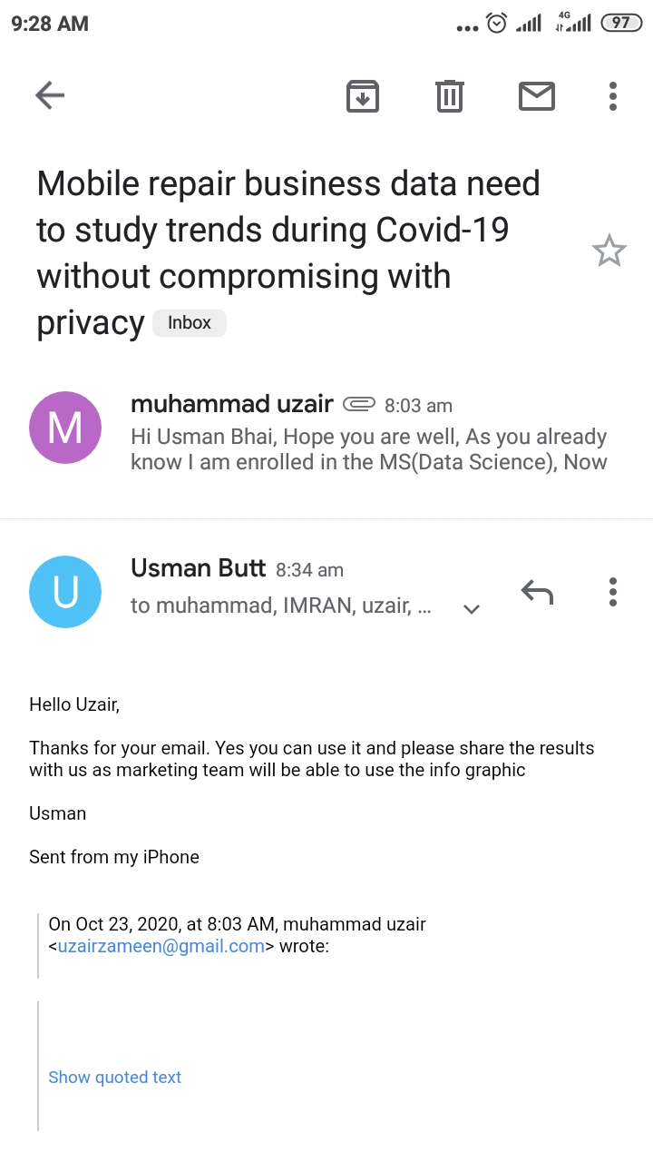
PERMISSION RELATED PROVE

Slide 6
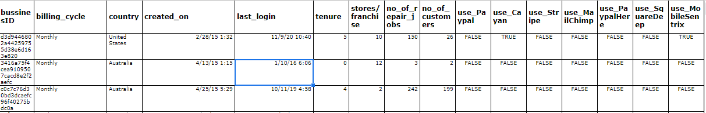

DATA SCHEMA

Slide 7
CHALLENGES
Data understanding and preparation
Clean data (remove blank, empty spaces, data formatting)
Dealing with Missing Values
Identify train and test data (60 and 40%)
Add additional attributes to data to minimize ambiguity (Binary flag Churn/No Churn)
Finding the right algorithm

Slide 8
Different Machine Learning Algorithms
Models | Major Types/Kernels | Performance Metrics
Linear Regression Models | Simple Linear Regression, Multiple Linear Regression, Robust Regression | RMSE, R Squared, MSE, MEAN Absolute Error(MEA), Accuracy, F Score, Confusion matrix, AUC ROC, PR curves
Regression Trees | Decision Trees, Fine Tree, Medium Tree, Coarse Tree | RMSE, R Squared, MSE, MEAN Absolute Error(MEA), Accuracy, F Score, Confusion matrix
Support Vector Machines (SVM) | Linear, Quadratic, Cubic, rbf, Gaussian | RMSE, R Squared, MSE,F Score, Confusion matrix, AUC ROC, PR curves
Ensembles of Trees | Boosted Trees, Bagged Trees | RMSE, R Squared, MSE, Accuracy

Slide 9
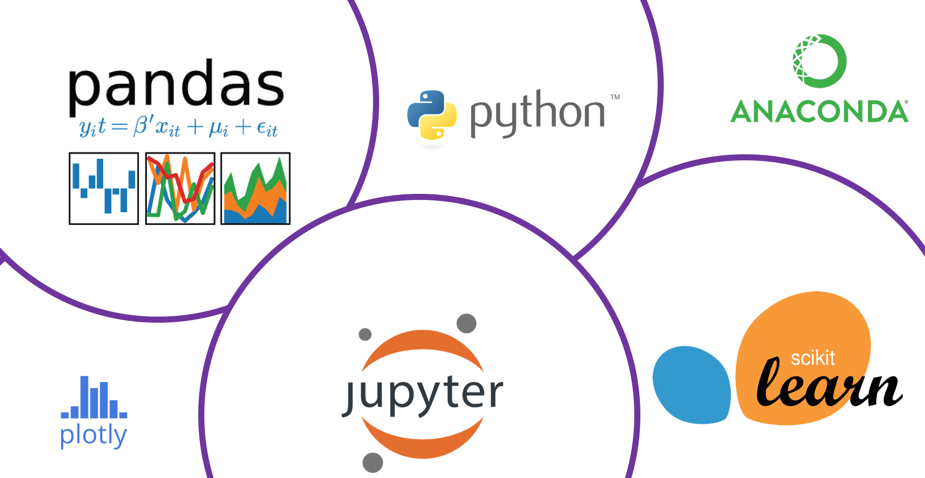
PYTHON/AWS TOOLS
AWS - Amazon forecast service
Pandas
Jupyter

Slide 10
GOALS
Our goal is to solve business problems for data to be valuable.
which customers are likely to churn, but also which features have the most impact on a customer leaving.
Revenue projection can turn data into opportunity
Vendor recommendation

Slide 11
THANKS!

